Slide 1
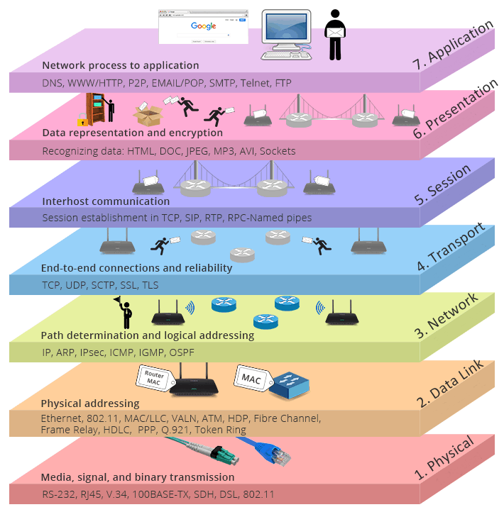
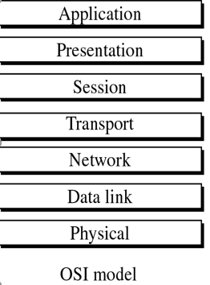
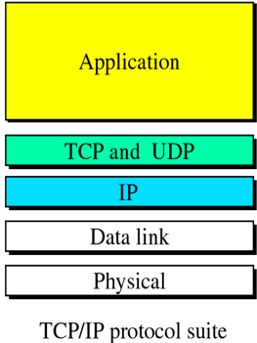
Network Models (OSI and TCP/IP)
Week 6 Part one

Slide 2
Introduction
Seven-layer OSI model.
Physical, Data Link, and Network Layers are the network support layers.
Transport Layer links the network support layers and the user support layers.
Transport Layer is responsible for the process-to-process delivery of the entire message.
TCP/IP is a five-layer hierarchical protocol suite developed before the OSI model.

Slide 3
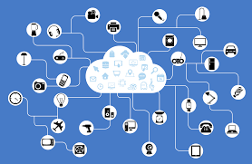
Network
It is estimated that by 2022 there will be over 21 billion fixed and mobile networked devices approximately.
A network is a combination of hardware and software that sends data from one location to another.
The hardware consists of the physical equipment (nodes) that carries signals from one point of the network to another.
The software consists of instruction sets that make possible use of the services that we expect from a network.
Voice
Data
Image
Video

Slide 4
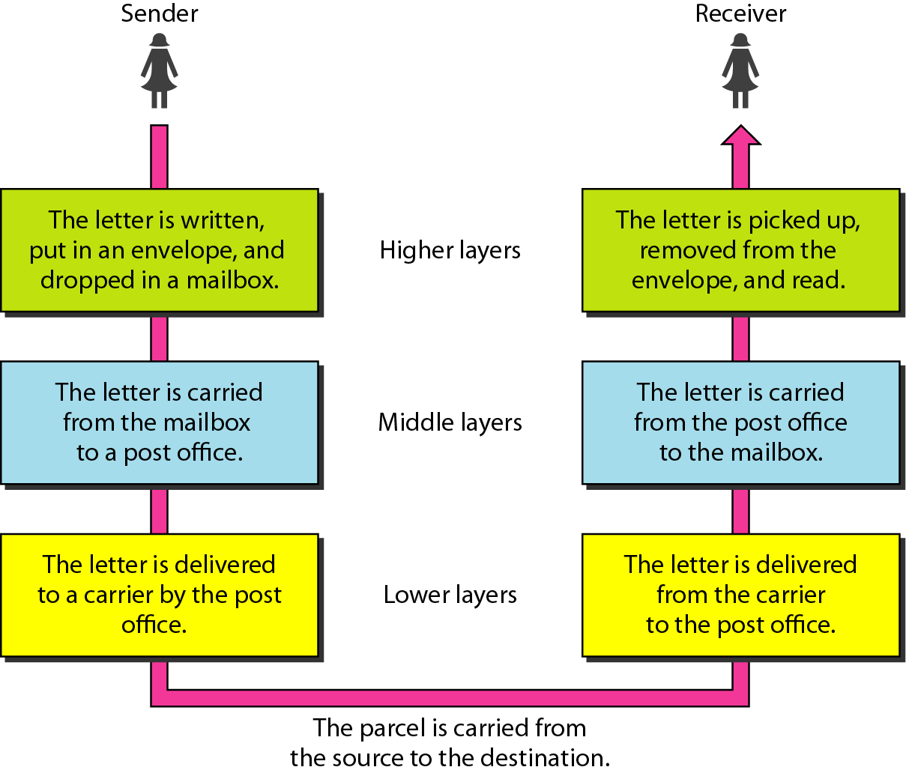
Layered Communication
We use the concept of layers in our daily life. For example, let us consider two friends who communicate through postal mail.
A sender, a receiver, and a carrier that transports the letter.
There is a hierarchy of tasks.
The letter is then on its way to the recipient.
On the way to the recipient's local post office, the letter may actually go through a central office.
In addition, it may be transported by truck, train, airplane, boat, or a combination of these.
Each layer at the sending site uses the services of the layer immediately below it.
The lowest layer uses the services of the carrier.
There is also a relationship between corresponding processes on the sender and receiver. One is the opposite of the other and they communicate using a protocol.

Slide 5
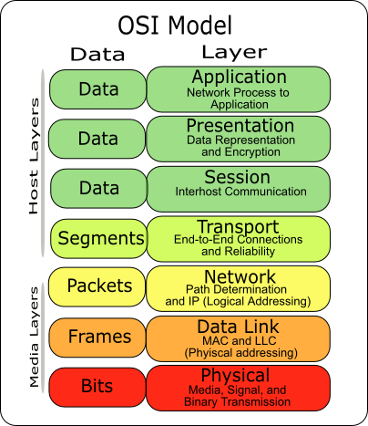
Open System International (OSI) Model
The demonstration of the OSI model is to facilitate communication between different systems without requiring changes to the logic of the underlying hardware and software.
The OSI model is a layered framework for the design of network systems that allows communication between all types of computer systems.
It consists of seven separate layers, each of which defines a part of the process of moving information across a network.
The designers created an architecture that is both comprehensive and flexible and the OSI model provides a complete coherence between incompatible systems.
Within a single machine, each layer calls upon the services of the layer just below it.
Figure shows the layers involved when a message is sent from device A to device B.

Slide 6
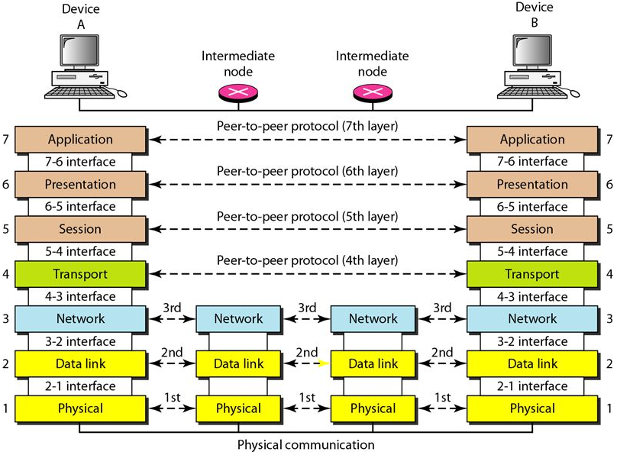
Peer-to-Peer Processes
Device A sends a message to Device B.
Communication must move down through the layers on Device A, over to Device B, and then back up through the layers.
Each layer in the sending device adds its own information to the message it receives from the layer just above it and passes the whole package to the layer just below it.
At Layer 1, the entire package is converted to a form that can be transmitted to the receiving device.
At the receiving machine, the message is unwrapped layer by layer, with each process receiving and removing the data meant for it.
For example, layer 2 removes the data meant for it, then passes the rest to layer 3. Layer 3 then removes the data meant for it and passes the rest to layer 4, and so on.

Slide 7
Interfaces Between Layers
The passing of the data and network information down through the layers is made possible by an interface between each pair of adjacent layers.
Each interface defines the information and services a layer must provide for the layer above it.
As long as a layer provides the expected services to the layer above it, the specific implementation of its functions can be modified or replaced without requiring changes to the surrounding layers.

Slide 8
Organization of the Layers
The seven layers can be thought of as belonging to three subgroups.
Network Support Layers
Or Media Layers
Layers 1, 2, and 3: physical, data link, and network are the network support layers; they deal with the physical aspects of moving data from one device to another (such as electrical specifications, physical connections, physical addressing, and transport timing).
Layers 5, 6, and 7: session, presentation, and application can be thought of as the User Support Layers.

Slide 9
OSI Model
APPLICATION – responsible for interactions with operating system or application. This layer provides application services for the file transfer, e-mail and other network software services (Telnet, FTP and HTTP).
PRESENTATION – responsible for delivery and formatting data into the form understanding for Application layer. Presentation layer ensures that data from one computer will be readable on the other one (Windows, Mac and Unix).
SESSION – responsible for establishing, management and terminating connection between applications. The session layer is responsible for the dialog control or conversation and synchronization Dialog Control (Half Duplex/ Full Duplex) .
TRANSPORT – The transport layer is responsible for the delivery of a message from one process to another as segments. It provides transparent data transfer between nodes and is responsible for end to end error recovery and flow control. When some data will be lost network layer will take care to bring them back. (TCP, UDP).

Slide 10
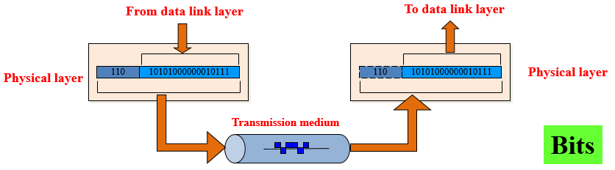
OSI Model
NETWORK – The network layer is responsible for the delivery of individual packets (protocol delivery) from the source host to the destination host. The layer which brings routing, addressing, error handling, internetworking technologies. Makes path to reach the target node through the network. (IP, ICMP)
DATA LINK – responsible for encoding and decoding physical layer into bits. Besides is responsible for error detection and frame synchronization. Data link layer consists of two sub-layers.
PHYSICAL – responsible for sending bit stream (electrical signals, light pulse, radio waves) through the network. It provides physical devices including cables, cards, interfaces. (USB, Bluetooth, Ethernet physical layer, SONET)
Synchronous optical networking (SONET)
Notes:
Internet Control Message Protocol (ICMP) is a TCP/IP network layer protocol that provides troubleshooting, control and error message services. ICMP is most frequently used in operating systems for networked computers, where it transmits error messages.
Synchronous optical networking (SONET) and synchronous digital hierarchy (SDH) are standardized protocols that transfer multiple digital bit streams synchronously over optical fiber using lasers or highly coherent light from light-emitting diodes (LEDs).

Slide 11
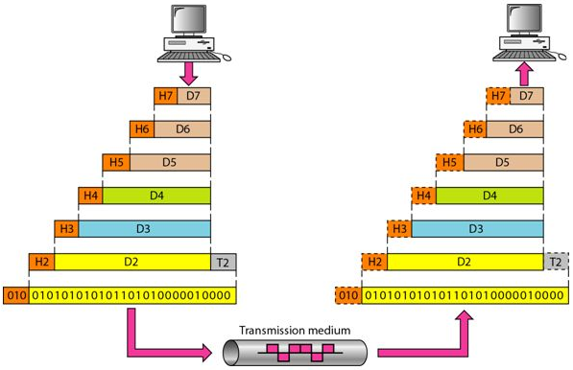
Overall view of OSI Layers
An overall view of the OSI layers, D7 means the data unit at layer 7, D6 means the data unit at layer 6, and so on.
At each layer, a header, or possibly a trailer, can be added to the data unit.
These trailers are helpful in error detection.

Slide 12
Data, Protocol & Activities
OSI Layers
TCP/IP Suite
Activities
Application
Application
HTTP, Telnet, FTP, SMTP, DNS, SNMP, Specific address etc…
To allow access to network resources
Presentation
Presentation
ASCII, JPEG
To translate, encrypt, and compress
data
Session
Session
Half duplex, Full duplex
To establish, manage, and terminate
session
Transport
Transport (Segments)
TCP, UDP, SCTP, Sockets and Ports address
To Provide reliable process-to-process
message delivery and error recovery
Network
Network (Packets)
IP, IPX, ARP/RARP, ICMP, IGMP, Logical address
To move packets from source to
destination; to provide internetworking
Data Link
Data Link (Frames)
MAC addresses
To organize bits into frames; to provide
Hop-to-Hop delivery
Physical
Physical (Bits)
Twisted pair cable, fiber and NICs
To Transmit bits over a medium; to provide
Mechanical and electrical specifications
Notes:
SCTP (Stream Control Transmission Protocol) is a protocol for transmitting multiple streams of data at the same time between two end points that have established a connection in a network. Sometimes referred to as "next generation TCP" (Transmission Control Protocol) - or TCPng, SCTP is designed to make it easier to support a telephone connection over the Internet (and specifically to support the telephone system's Signaling System 7 - SS7 - on an Internet connection). A telephone connection requires that signaling information (which controls the connection) be sent along with voice and other data at the same time. SCTP also is intended to make it easier to manage connections over a wireless network and to manage the transmission of multimedia data. SCTP is a standard protocol (RFC 2960) developed by the Internet Engineering Task Force (IETF).
Internetwork Packet Exchange (IPX) is the network layer protocol in the IPX/SPX protocol suite. IPX is derived from Xerox Network Systems' IDP. It may act as a transport layer protocol as well.
Domain Name Servers (DNS) are the Internet's equivalent of a phone book. They maintain a directory of domain names and translate them to Internet Protocol (IP) addresses. DNS queries consist of a single UDP request from the client followed by a single UDP reply from the server. The Transmission Control Protocol (TCP) is used when the response data size exceeds 512 bytes, or for tasks such as zone transfers.
The Hypertext Transfer Protocol (HTTP) is an application protocol for distributed, collaborative, hypermedia information systems. HTTP is the foundation of data communication for the World Wide Web. Hypertext is structured text that uses logical links (hyperlinks) between nodes containing text.
Telnet is a protocol that enables you to connect to remote computers and local computers over a TCP/IP network, over TCP port 23. By default, Telnet is disabled in recent Windows environments. To enable Telnet command line utilities: Click Start > Control Panel. Click Programs and Features.
File Transfer Protocol (FTP) is a standard Internet protocol for transmitting files between computers on the Internet over TCP/IP connections.
FTP is a client-server protocol that relies on two communications channels between client and server: a command channel for controlling the conversation and a data channel for transmitting file content. Clients initiate conversations with servers by requesting to download a file. Using FTP, a client can upload, download, delete, rename, move and copy files on a server. A user typically needs to log on to the FTP server, although some servers make some or all of their content available without login, also known as anonymous FTP.
SMTP, POP3 and IMAP are TCP/IP protocols used for mail delivery. If you plan to set up an email server such as hMailServer, you must know what they are used for. Each protocol is just a specific set of communication rules between computers.
Simple Network Management Protocol (SNMP) is an Internet-standard protocol for collecting and organizing information about managed devices on IP networks and for modifying that information to change device behavior. Devices that typically support SNMP include routers, switches, servers, workstations, printers, modem racks and more.
Joint Photographic Experts Group (JPEG) is a method to compress pictures and graphics.

Slide 13
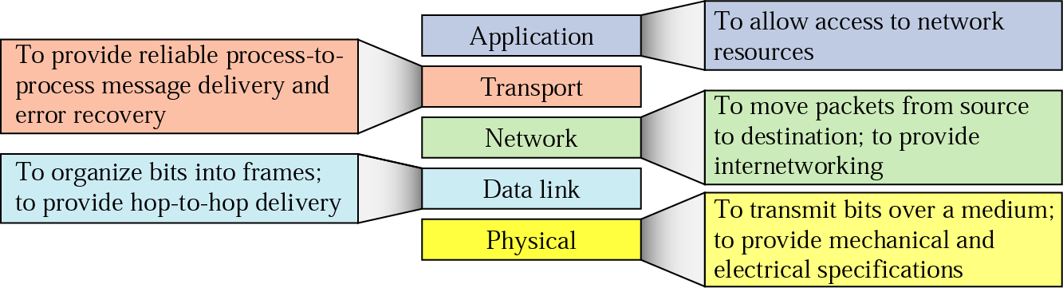
The TCP/IP Internet Model
The TCP/IP Internet model was developed prior to the OSI model.
It contributed to the development of OSI model.
The TCP/IP Internet model uses 5 layers instead of 7 layers.
Currently the OSI model is used more in Europe while the TCP/IP model is used more in the US.
The OSI model may be viewed as more ‘theoretical’.
Layer 3, the Network layer is also known as the Internet Protocol (IP) layer.

Slide 14
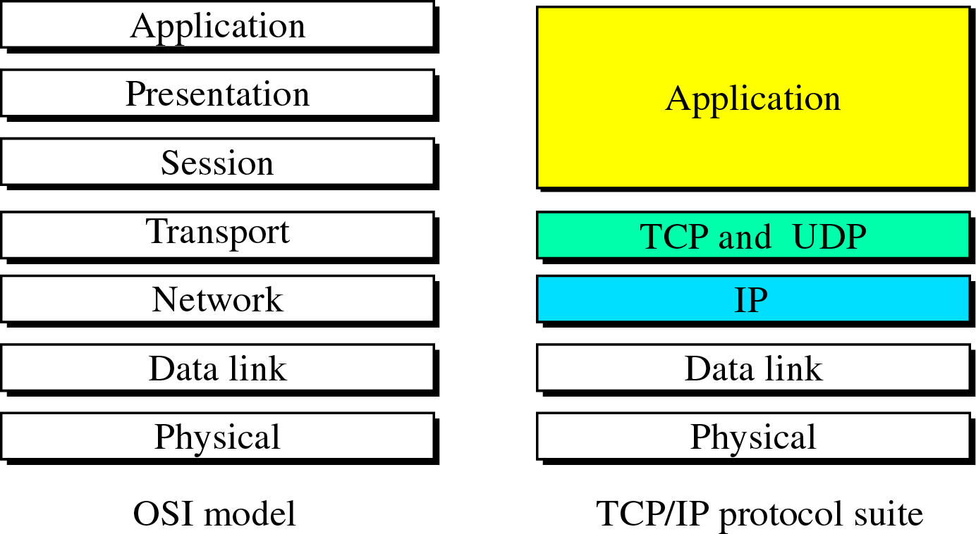
OSI and the TCP/IP Model

Slide 15
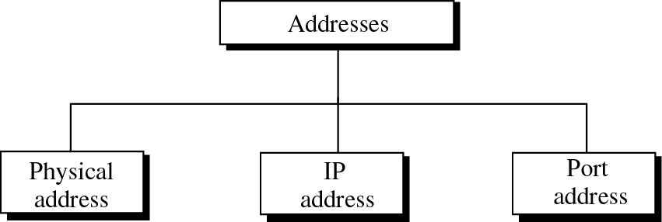
Addressing
Three different levels of addresses are used in the TCP/IP Internet model:
Physical MAC (Media Access Control) addressing at the Data Link layer
Logical (IP) addressing at the Network Layer
Port addressing at the Transport Layer
Data Link layer
Network Layer
Transport Layer

Slide 16
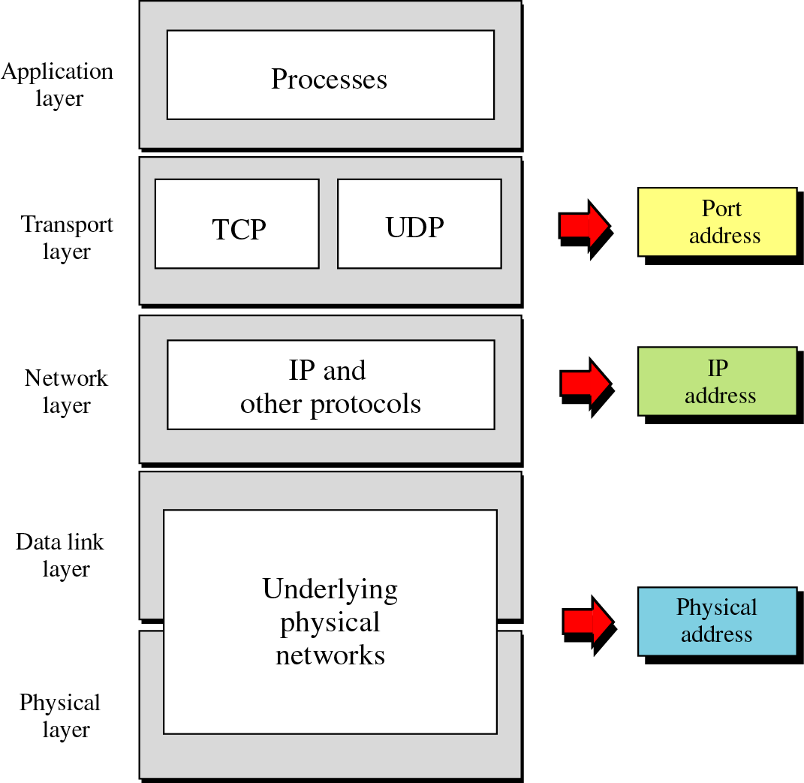
Addressing
Four levels of addresses are used in an internet employing the TCP/IP protocols:
Physical (link) Addresses
Logical (IP) Addresses
Port Addresses
Specific Addresses
Each address is related to a specific layer in the TCP/IP architecture, as shown in Figure.
Notes:
Physical Address
ipconfig /all
Logical Address
The logical IP address is known as IPV4 address and new address is called as IPV6
Port Address
netstat -an

Slide 17
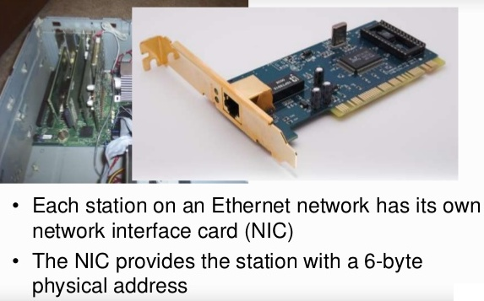
Physical Addressing
The physical address is known as the link address, is the address of a node as defined by its LAN or WAN.
It is included in the frame used by the data link layer.
It is the lowest-level address.
The physical addresses have authority over the network (LAN or WAN).
The size and format of these addresses vary depending on the network.
For example, Ethernet uses a 6-byte (48-bit) physical address that is imprinted on the network interface card (NIC).
ipconfig /all
07:01:02:01:2C:4B
A 6-byte (12 hexadecimal digits) physical address
Notes:
Ethernet is a system for connecting a number of computer systems to form a local area network, with protocols to control the passing of information and to avoid simultaneous transmission by two or more systems.
The tunnel adapter encapsulates IP6 packets with an IP4 header so that it can be sent across an IP4 network without issue.

Slide 18
Physical Addressing
Physical Media Access Control (MAC) addressing happens at Layer 2, the Data Link layer.
The header that is added and subtracted by Layer 2 contains the source and destination physical addresses.
On the next slide a device with physical address 10 sends a frame to a device with physical address 87.

Slide 19
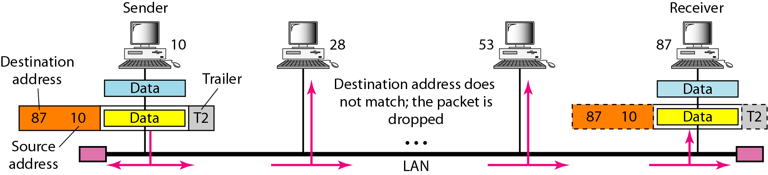
Physical Addressing
The two devices are connected by a link (bus topology LAN).
The computer with physical address 10 is the sender, and the computer with physical address 87 is the receiver.
The trailer usually contains extra bits needed for error detection.
Each station with a physical addresses other than 87 drops the frame because the destination address in the frame does not match its own physical address.
The frame is checked, the header and trailer are dropped, and the data part is decapsulated and delivered to the upper layer.

Slide 20
Logical Addressing
Logical addresses are necessary for universal communications that are independent of underlying physical networks.
The header that is added and subtracted by Layer 3 contains the source and destination logical (IP) addresses.
Each device (computer or router) has a pair of addresses (logical and physical) for each LAN connection.
No two publicly addressed and visible hosts on the Internet can have the same IP address.
The IP layer requires a 4 (IPv4) or 6 (IPv6) byte address to be assigned to each network interface card on each computer.
IP address (32 bits): 192.168.0.19

Slide 21
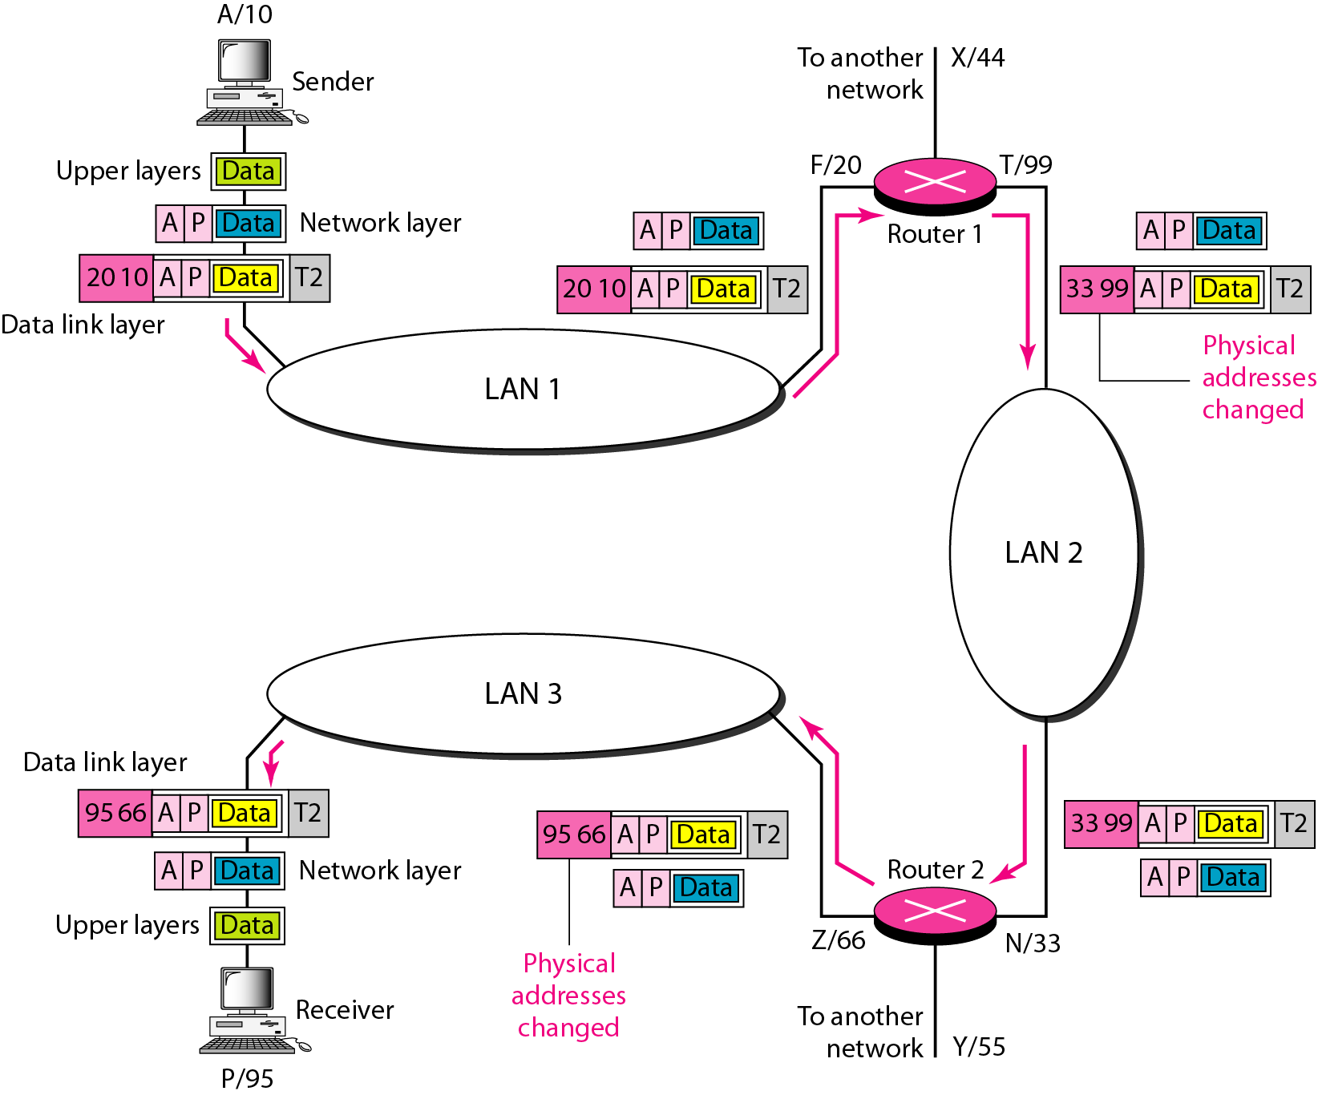
Logical Addressing
Two routers connecting three LANs.
Each device (computer or router) has a pair of addresses (logical and physical) for each connection.
In this case, each computer is connected to only one link and has only one pair of addresses.
Each router is connected to three networks (only two are shown in the figure).
So each router has three pair of addresses, one for each connection.

Slide 22
Logical Addressing
The physical addresses will change from hop to hop, but the logical addresses must remain the same.
The computer with logical address A and physical address 10 needs to send a packet to the computer with logical address P and physical address 95.
We can use letters to show the logical addresses and numbers for physical addresses, but note that both are actually numbers.
Notes:
Explanation
The sender encapsulates its data in a packet at the network layer and adds two logical addresses (A and P).
In most protocols, the logical source address comes before the logical destination address (contrary to the order of physical addresses).
The network layer, however, needs to find the physical address of the next hop before the packet can be delivered.
In computer networking a routing table, or routing information base (RIB), is a data table stored in a router or a networked computer that lists the routes to particular network destinations, and in some cases, metrics (distances) associated with those routes. The routing table contains information about the topology of the network immediately around it.
The network layer consults its routing table and finds the logical address of the next hop (router I) to be F.
The ARP discussed previously finds the physical address of router 1 that corresponds to the logical address of 20.
Now the network layer passes this address to the data link layer, which in turn, encapsulates the packet with physical destination address 20 and physical source address 10.
The frame is received by every device on LAN 1, but is discarded by all except router 1, which finds that the destination physical address in the frame matches with its own physical address.
The router decapsulates the packet from the frame to read the logical destination address P. Since the logical destination address does not match the router's logical address, the router knows that the packet needs to be forwarded.
The router consults its routing table and ARP to find the physical destination address of the next hop (router 2), creates a new frame, encapsulates the packet, and sends it to router 2.
The source physical address changes from 10 to 99.
The destination physical address changes from 20 (router 1 physical address) to 33 (router 2 physical address).
The logical source and destination addresses must remain the same; otherwise the packet will be lost.
At router 2 we have a similar scenario. The physical addresses are changed, and a new frame is sent to the destination computer.
When the frame reaches the destination, the packet is decapsulated.
The destination logical address P matches the logical address of the computer. The data are decapsulated from the packet and delivered to the upper layer.
Note that although physical addresses will change from hop to hop, logical addresses remain the same from the source to destination.

Slide 23
Logical Addressing
The sender encapsulates its data in a packet at the network layer and adds two logical addresses (A and P).
The network layer needs to find the physical address of the next hop before the packet can be delivered.
The network layer consults its routing table and finds the logical address of the next hop (router One) to be F.
Address Resolution Protocol (ARP) finds the physical address of router One that corresponds to the logical address (F) of 20.
Further, the network layer passes this address to the data link layer, which encapsulates the packet with physical destination address 20 and physical source address 10.

Slide 24
Logical Addressing
The frame is received by every device on LAN 1, but is discarded by all except router 1, which finds that the destination physical address in the frame matches with its own physical address.
The router de-capsulates the packet from the frame to read the logical destination address P. Since the logical destination address does not match the router's logical address (F), the router knows that the packet needs to be forwarded.
The router consults its routing table and ARP to find the physical destination address of the next hop (router 2), creates a new frame, encapsulates the packet, and sends it to router 2.
The source physical address changes from 10 to 99.
The destination physical address changes from 20 (router 1 physical address) to 33 (router 2 physical address).

Slide 25
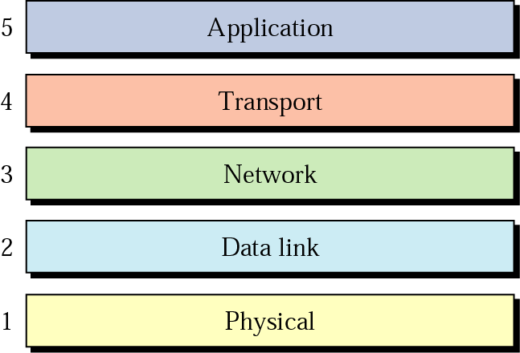
Port Addressing
Suppose a computer A can communicate with computer C by using Telnet.
At the same time, computer A communicates with computer B by using the File Transfer Protocol (FTP).
For these processes to receive data simultaneously, we need a method to label the different processes.
In the TCP/IP architecture, the label assigned to a process is called a Port Address.
A port address in TCP/IP is 16 bits in length.
753
A 16-bit port address represented as one single number.

Slide 26
Port Addressing
For example, the port 23 is used for telnet services, and HTTP uses port 80 for providing web browsing service.
There is a group called the IANA (Internet Assigned Numbers Authority) that controls the assigning of ports for specific services.
There are some ports that are assigned, some reserved and many unassigned which may be utilized by application programs.
Port numbers are straight unsigned integer values which range up to a value of 2¹⁶ = 0 to 65535.

Slide 27
Port Addressing
Port addressing happens at Layer 4, the Transport layer.
The header that is added and subtracted by Layer 4 contains the source and destination port addresses.
The figure on next slide shows two computers communicating via the Internet.
The sending computer is running three processes at this time with port addresses a, b and c.
The receiving computer is running two processes at this time with port addresses j and k.
Process a in the sending computer needs to communicate with process j in the receiving computer.
Although, the physical addresses change from hop to hop, logical and port addresses usually remain the same from the source to destination.

Slide 28
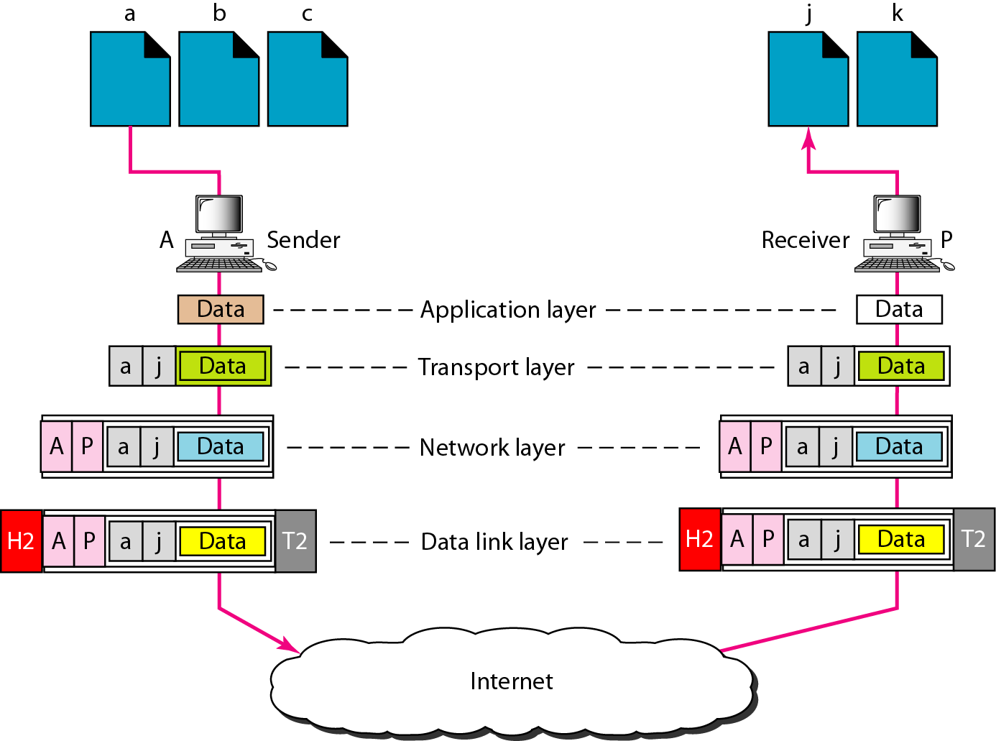
Port Addressing
Process a in the sending computer needs to communicate with process j in the receiving computer.
3 processes
2 processes
Both computers are using the same application, FTP, for example, the port addresses are different because one is a client program and the other is a server program.
The transport layer encapsulates data from the application layer in a packet and adds two port addresses (a and j), source and destination.

